Slide 1

Vince Conforti
639 North Main Street
Glen Ellyn, IL 60137
38894-CJC
Basement and Basement Bath Remodeling Project
Material Selections
Judy Hogel
Judy@megapros.com
847-652-4185

Slide 2
Basement Flooring
____________________________________________________________________
Total Allowances: $8,050.00
$250.00 Permit Allowance
$600.00 Interior Doors & Hardware
$6,500.00 LVT Flooring
$700.00 Door Casing, Trim & Baseboards

Slide 3

Kitchen Paint
Walls: Pearl River
Finish: Eggshell
Ceiling: Ceiling White
Samples order 9/3/25

Slide 4
Basement Bathroom
____________________________________________________________________
Note: Not in Contract, Material out of allowance number. Labor will be an additional cost

Slide 5
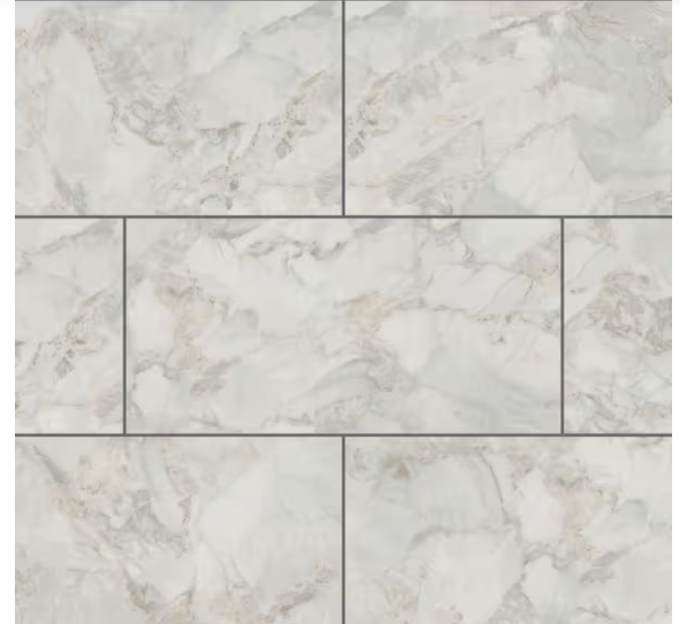
Bath Flooring Final
Vendor: Home Depot
LifeProof
Ashen Grove Marble 22 MIL x 11.9 in. W x 23.8 in. L Click Lock Waterproof Vinyl Tile Flooring
Model # SI69413L
https://www.homedepot.com/p/Lifeproof-Ashen-Grove-Marble-22-MIL-x-11-9-in-W-x-23-8-in-L-Click-Lock-Waterproof-Vinyl-Tile-Flooring-17-7-sq-ft-case-SI69413L/327716551

Slide 6

Bath Faucet Final
Vendor: Ferguson
Delta Arvo 1.2 GPM Single Hole Bathroom Faucet with Pop-Up Drain Assembly
Model: 15840LF-SP
Brushed Nickel
https://www.fergusonhome.com/delta-15840lf/s1785575?uid=4220734

Slide 7
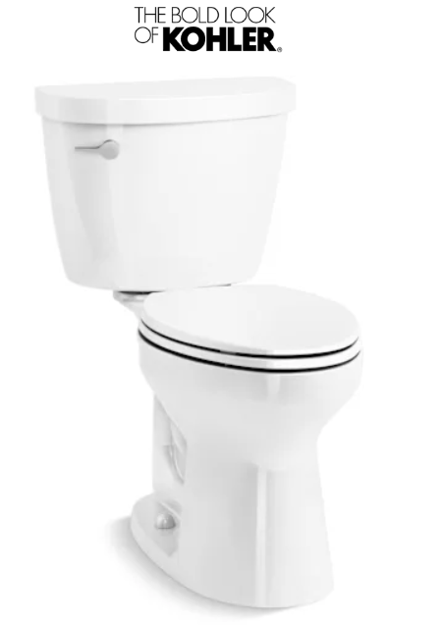
Toilet Final
Vendor: Ferguson
Brand: Kohler
Kohler Cimarron 1.28 GPF Two Piece Elongated Toilet with Left Hand Lever - Seat Included
Model: K-31626-DRY-0
https://www.fergusonhome.com/kohler-k-31626-dry/s2032834?uid=4874637

Slide 8
Basement Flooring
____________________________________________________________________

Slide 9

Flooring & Stairs Final
Vendor: Home Depot
Lifeproof
Chiffon Lace Oak 22 MIL x 8.7 in. W x 48 in. L Click Lock Waterproof Luxury Vinyl Plank Flooring
Model # I412211LP
https://www.homedepot.com/p/Lifeproof-Chiffon-Lace-Oak-22-MIL-x-8-7-in-W-x-48-in-L-Click-Lock-Waterproof-Luxury-Vinyl-Plank-Flooring-20-1-sqft-case-I412211LP/311573442

Slide 10
Doors, Railing, Trim & Harware
____________________________________________________________________

Slide 11
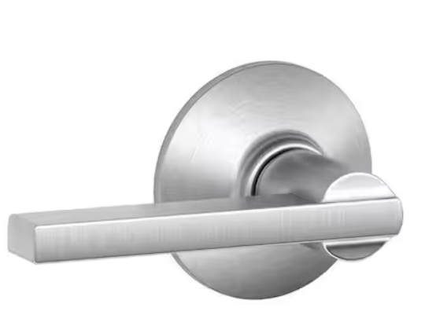
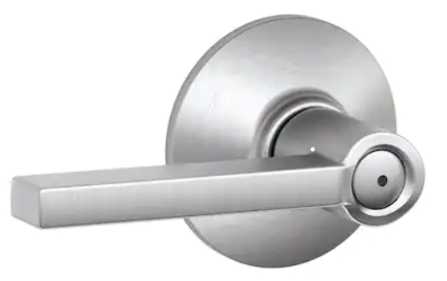
Door Knobs Final
Vendor: Home Depot
Schlage Latitude Satin Chrome Passage Hall/Closet Door Handle & Privacy Handle
Model # F40 LAT 626
Model # F10 LAT 626
https://www.homedepot.com/p/Schlage-Latitude-Satin-Chrome-Privacy-Bed-Bath-Door-Handle-F40-LAT-626/203730168
https://www.homedepot.com/p/Schlage-Latitude-Satin-Chrome-Passage-Hall-Closet-Door-Handle-F10-LAT-626/203730151

Slide 12
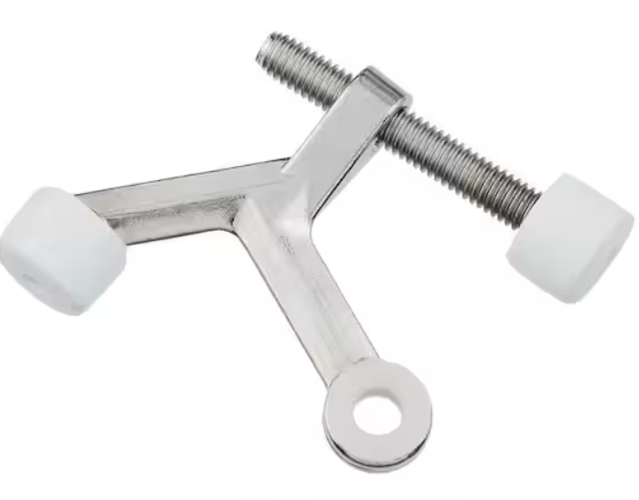
Door Hinge Pin Stops Final
Vendor: Home Depot
Chrome Light Duty Hinge Pin Door Stop
Model # 28067
https://www.homedepot.com/p/Everbilt-Chrome-Light-Duty-Hinge-Pin-Door-Stop-28067/314151593

Slide 13
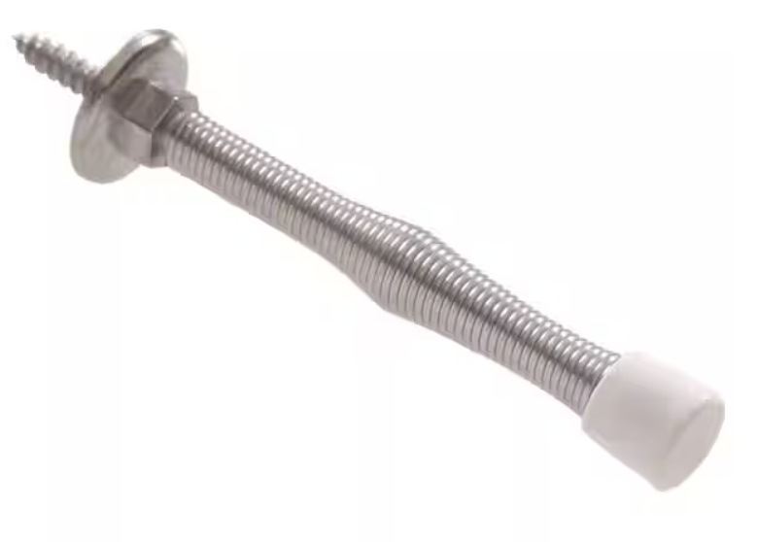
Door Hinge Pin Stops Final
Vendor: Home Depot
Hardware Es3 in. Satin Chrome Utility Spring Door Stop
Model # 852926.0
https://www.homedepot.com/p/Hardware-Essentials-3-in-Satin-Chrome-Utility-Spring-Door-Stop-5-Pack-852926-0/203810590

Slide 14
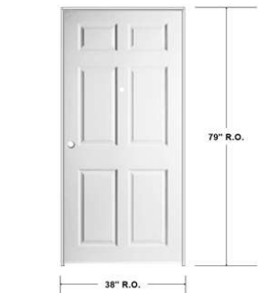
6 – Panel Doors

Slide 15
Stair Handrail

Slide 16
Light Switches and Outlets
Service Plus will Supply

